Slide 1
Boring Processor
Jordan Ansari, Ian Barthel, Logan Bryant, Hunter Masur
Notes:
Ian

Slide 2
Cool Processor
Jordan Ansari, Ian Barthel, Logan Bryant, Hunter Masur
Notes:
Ian

Slide 3
Architecture Adventure
Our processor follows an accumulator style, similar to the Gameboy
We chose this because it seemed feasible but unique (and people said not to do Stack)
The processor is also multi-cycle
Notes:
Ian

Slide 4
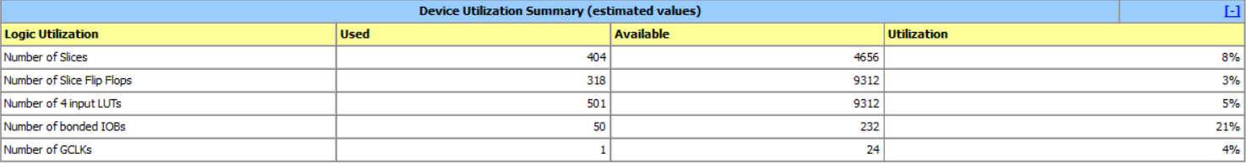
Benchmarks for relPrime of 5040
No. of Bytes required: 106
No. of instructions: 122,484
No. of cycles: 469,460
Average CPI: 3.83
Cycle Time: 11.871ns = 84.24 MHz
Execution Time = 5.573 ms
Notes:
Ian

Slide 5
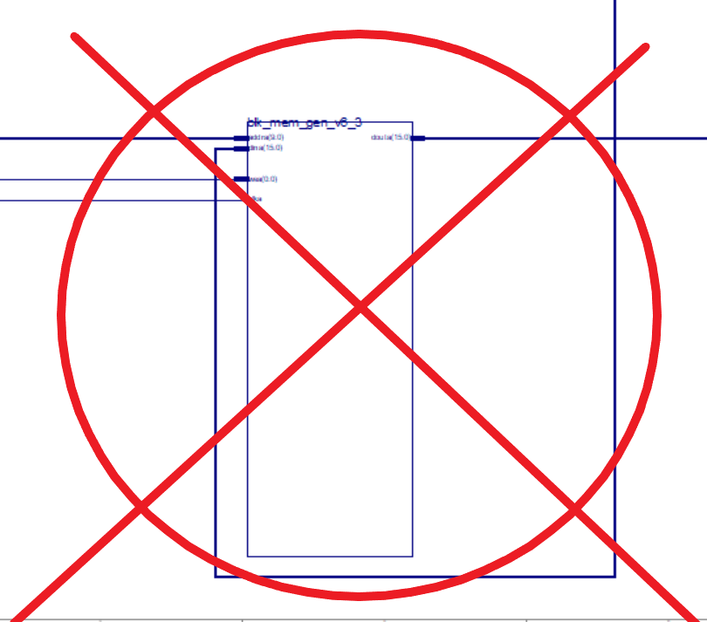
Main Attractions
Three Accumulators
Limits need for memory access
Two Register Files
Different Sized Opcodes
Further jumps/branches
Notes:
Ian

Slide 6
Unique Aspects: Cool Registers
Our process contains 3 different accumulators (known as Cool Registers/CRs), able to be swapped between via the “Mov” instruction
This did not decrease performance and allowed for easier coding
Cool Registers are stored in a separate register file, meaning they can be used as a separate input to the ALU
Being able to swap between cool registers decreases memory access
They’re super cool
Notes:
Jordan

Slide 7
Main Attractions: Instructions
We have different sized opcodes for Branch/Jump instructions and all others
Branch/Jump instructions start with 1 and are 3 bits long
All other instructions start with 0 and are 5 bits long
This allows for the jump range to be 13 bits instead of 10
While this didn’t come into play in a 10-bit address space, it would be useful in a different context with a 16-bit address space
Notes:
Logan

Slide 8
Main Attractions: Assembler
Made in Java
Turns assembly code into the binary or hexadecimal equivalent
Supports labels (uses a Hashmap to store the label’s address)
Super cool
Notes:
Hunter

Slide 9
Instruction Set
Mov n: Switch current accumulator register to the given value n (0-2)
Set $_: Set the value of the current accumulator register to $_
Setc $_: Set the value of $_ to the current accumulator’s value
Sw $_: Store $cr at address $_
Lw $_: Load the value from $_ into $cr
SetPC n: Store $PC+2 + n shifted left by 1 (usually will be 0)
GetIn $_: Load the outside input into $_ (selected register in register file)
Notes:
Logan

Slide 10
Instruction Set (Continued)
Sub $_: Subtract value of $_ from $cr
Add $_: Add value of $_ to $cr
Addi n: Add n to $cr
Sll n: Shift the bits of $cr to the left by n
J LABEL: Jump to the label in the instructions
Beq LABEL: Jump to the label in instructions if $cr is equal to 0
Bne LABEL: Jump to the label in instructions if $cr is not equal to 0
Notes:
Logan

Slide 11
Code Snippets
Storing 8 at address $t1:
Mov $cr1
Set $0
Addi 8
Sw $t1
Loading from address $t1:
Mov $cr1
Lw $t1
Recursive code:
RECUR: Mov $cr1
Set $a1
Beq DONE
Addi -1
Setc $a1
J RECUR
Notes:
Jordan

Slide 12
Code Snippets (Continued)
Jump and Link:
Mov $cr1
Set $sp
Addi -4
Setc $sp
Set $ra
Sw $sp
J LABEL
$a1 < $t1?
Mov $cr1 #These 2 lines are
Set $a1 #not necessary
Mov $cr2
Set $t1
Slt $a1
Beq a1LTt1
j a1GTt1
Notes:
Jordan

Slide 13
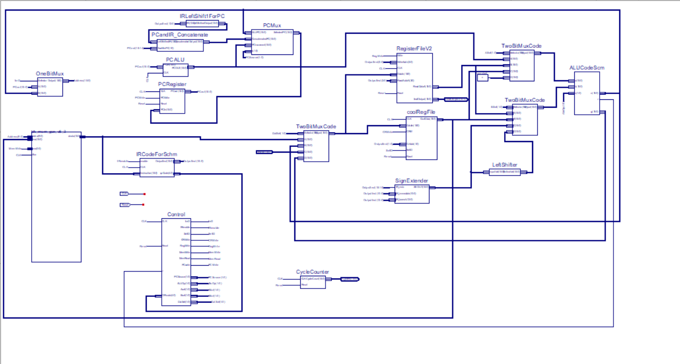
Behind the Scenes: Datapath
Notes:
Ian

Slide 14
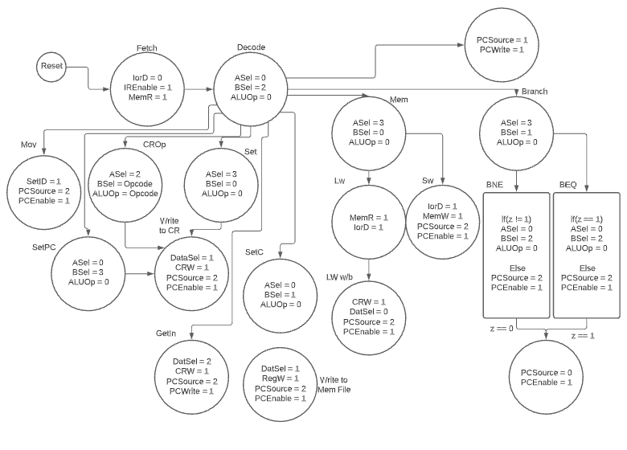
Behind the Scenes: State Machine
Note: All final states return to Fetch when complete
Notes:
Logan

Slide 15
Behind the Scenes: RTL
Step | R-type |  | Lw/Sw | Mov |  | Beq/Bne | J
Inst Fetch | IR = Mem[PC] PC = PC+2
Inst Decode | Op = IR[15-11] Addr/Imm = IR[10-0] OR (Reg = Reg[IR[3-0]], CR = CoolReg[IR[1-0]]) |  |  |  |  | Op = IR[15-13] Addr/Imm = IR[12-0]
Execution Mov done Beq/Bne/J done | ALUOut = A op B | ALUOut = A | ALUOut = | CurCool = IR[2-0] | CurCool = IR[2-0] | Beq: If A == 0 Bne: If A != 0 Then PC += (IR[12-0]<1) | PC = PC[15-14]+(IR[12-0]<1)
Mem Access R-type done Lw/Sw done | Reg[CurCool] = ALUOut | Sw: Mem[ALUOut] = CR Lw: CoolReg[CurCool] = Mem[ALUOut] | Mem[ALUOut] = CR
Note: A and B are determined by the control signals ASel and BSel
Notes:
Jordan

Slide 16
Our Testing Plan
Testing Strategy:
Looping through all possible values for signals and using arbitrary data. Adding specific tests for edge case
Phase 1: Individual component testing
Phase 2: Subcomponent Testing
Component 1: PC Logic (concat, shift, mux, +2)
Component 2: ALU Logic (CR, Registers, ALU )
Phase 3: Instruction testing
Phase 4: Datapath testing
Notes:
Hunter

Slide 17
Wrap-Up: The Challenges We Faced
Beq/Bne: The instructions are too small to both include a register to compare and address to jump to
We decided Beq/Bne would compare the current CR to 0 and branch accordingly
Lwc/Swc: Originally, users could load from memory into both the CRs and regular registers
This would require several changes to the datapath, including more complicated pathing and additional control signals
Slt: We thought we could get away with not having an slt, but realized late into the project this was not the case
Assembly: We completely rewrote our assembly code for Euclid's
Notes:
Hunter

Slide 18
Wrap-Up: What We Would do Differently
Spend more time on the individual milestones to allow for quicker work on the later weeks
May enable us to add more features
Be even cooler
Notes:
Hunter

Slide 19
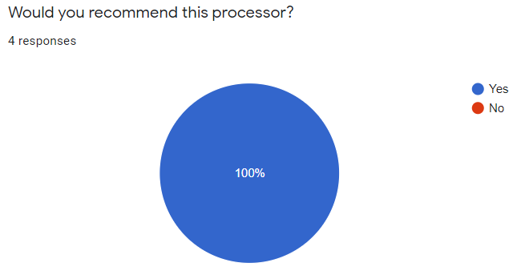
Conclusion
Our processor is worth investing $5 in
Having 3 accumulators makes coding much more user friendly
We have a good set of instructions to support anything code would need
It’s multi-cycle, which increases its performance
Our processor comes packaged with an assembler to make converting from instructions to machine code easy
Anonymous Survey results
Notes:
Jordan

Slide 20
Thank you!
Questions?
Notes:
Ian

Slide 21

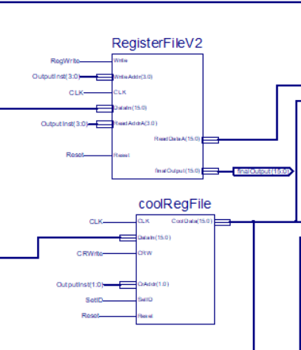
Cool Register & Register File

Slide 22
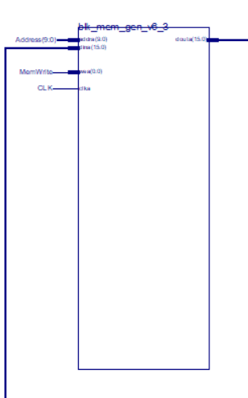
Memory

Slide 23
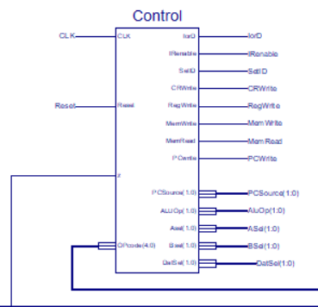
Control Unit

Slide 24
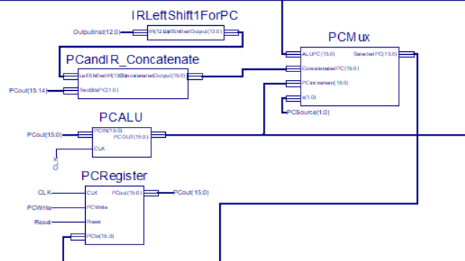
PC

Slide 25
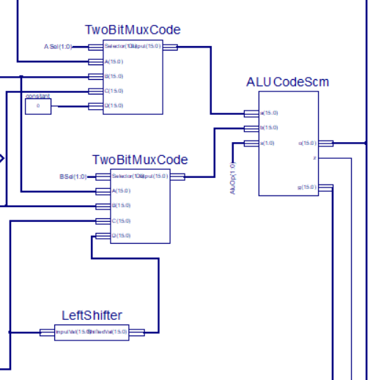
ALU

